Slide 1

Algebra 1
Unit 4, Lesson 9 Discovering Relationships of Parallel and Perpendicular Lines Volume 1, pg. 208

Slide 2


Benchmark
MA.912.AR.2.3
Write a linear two-variable equation for a line that is parallel or perpendicular to a given line and goes through a given point.
volume 1, pg. 208

Slide 3
Integrated Mathematical Thinking and Reasoning Standards
MA.K12.MTR.1.1 Actively participate in effortful learning both individually and collectively.
MA.K12.MTR.2.1 Demonstrate understanding by representing problems in multiple ways.
MA.K12.MTR.4.1 Engage in discussions that reflect on the mathematical thinking of self and others.
MA.K12.MTR.5.1 Use patterns and structure to help understand and connect mathematical concepts.
volume 1, pg. 208

Slide 4

Learning Targets
I can discover the relationship between parallel lines.
I can discover the relationship between perpendicular lines.
volume 1, pg. 208

Slide 5

Warm-Up
volume 1, pg. 208

Slide 6

4.9.1 Warm-Up: Notice and Wonder
What do you notice?
What do you wonder?
Write a question about the picture for the class.
volume 1, pg. 208
Notes:
Video Link: https://algebranation.wistia.com/medias/fi4fidi5y8

Slide 7

Exploration
volume 1, pg. 209

Slide 8

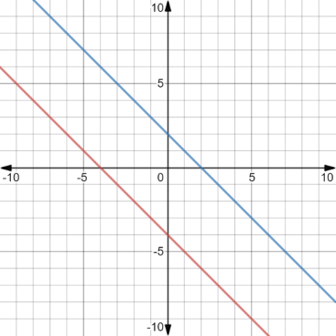
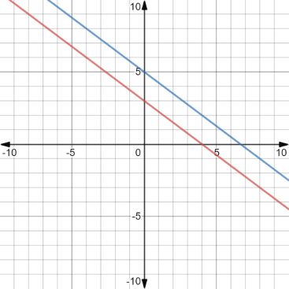
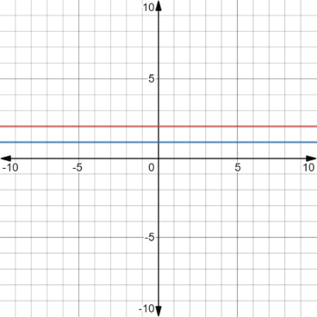
4.9.2 Exploration: Parallel Lines
Examine the pairs of parallel lines.
Write down your observations and questions.
Parallel Lines Set A | Parallel Lines Set B | Parallel Lines Set C
volume 1, pg. 209

Slide 9
Observations | Questions
volume 1, pg. 209

Slide 10
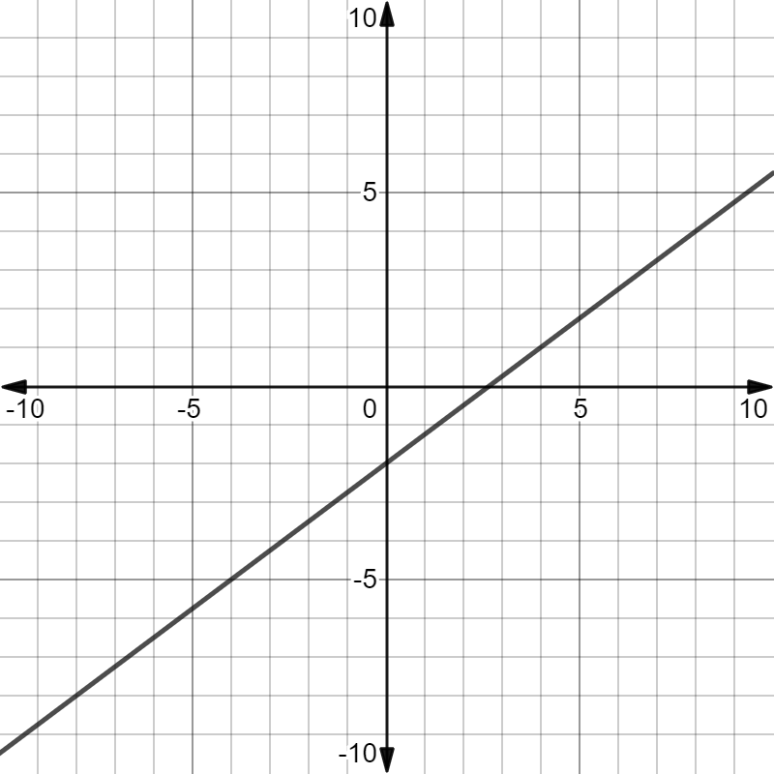
The graph of $y=\frac{3}{4}x−2$ is shown on the coordinate grid.
volume 1, pg. 209

Slide 11
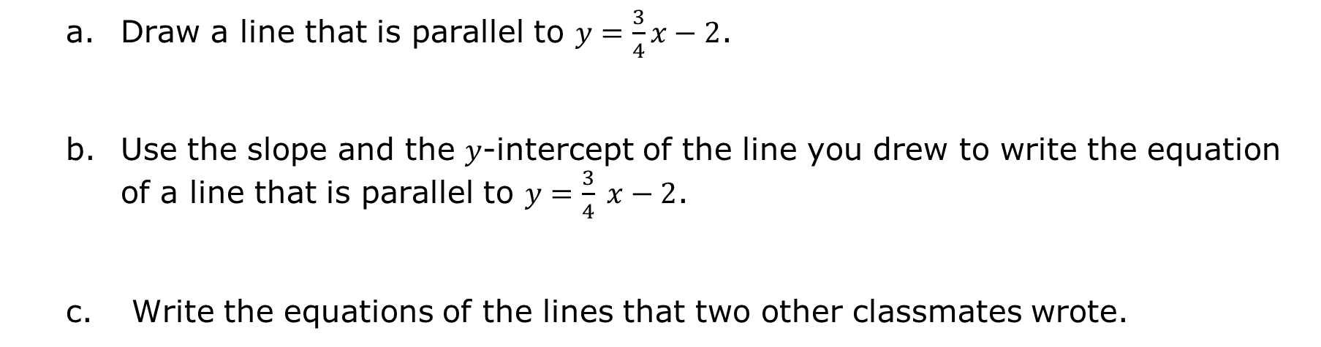
Draw a line that is parallel to $y=\frac{3}{4}x−2$.
Use the slope and the 𝑦-intercept of the line you drew to write the equation of a line that is parallel to $y=\frac{3}{4} x−2$.
Write the equations of the lines that two other classmates wrote.
Classmate | Equation
volume 1, pg. 209

Slide 12
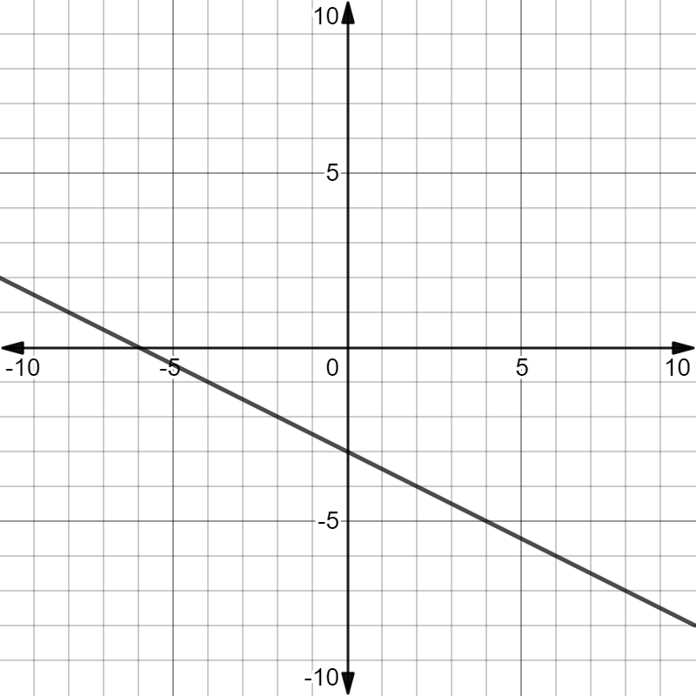
The graph of $y=−\frac{1}{2} x−3$ is shown on the coordinate grid.
volume 1, pg. 210

Slide 13
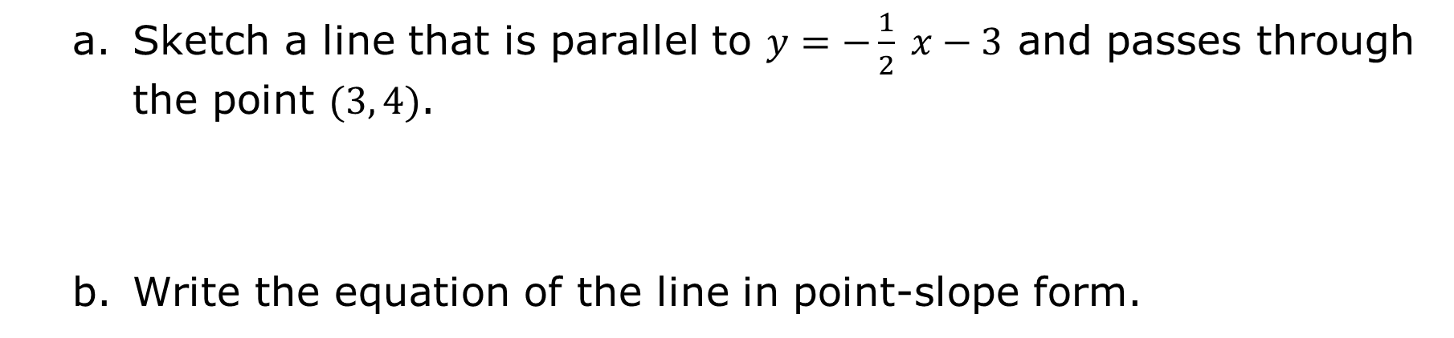
Sketch a line that is parallel to $y=−\frac{1}{2} x−3$ and passes through the point $(3, 4)$.
Write the equation of the line in point-slope form.
volume 1, pg. 210

Slide 14
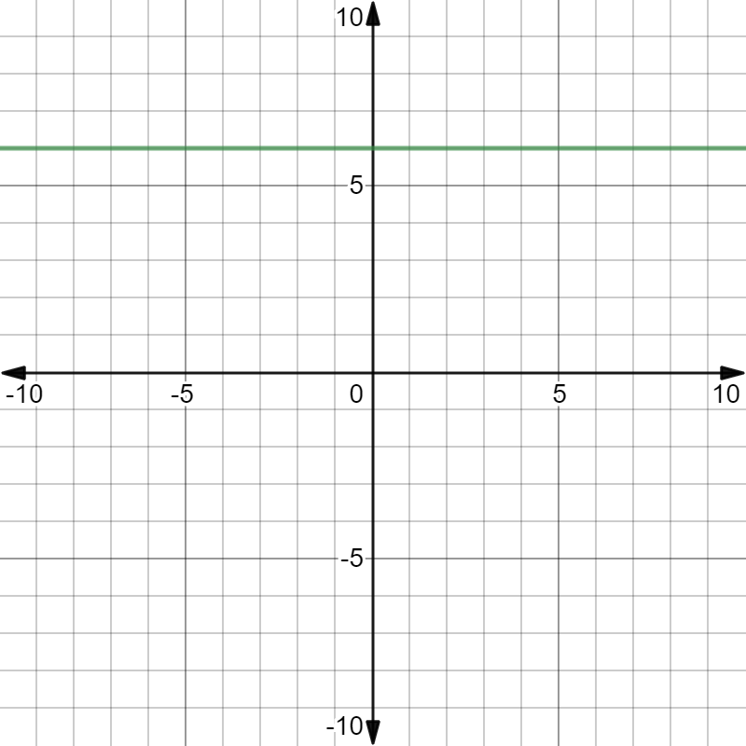
The graph of $y=6$is shown on the coordinate grid.
volume 1, pg. 210

Slide 15
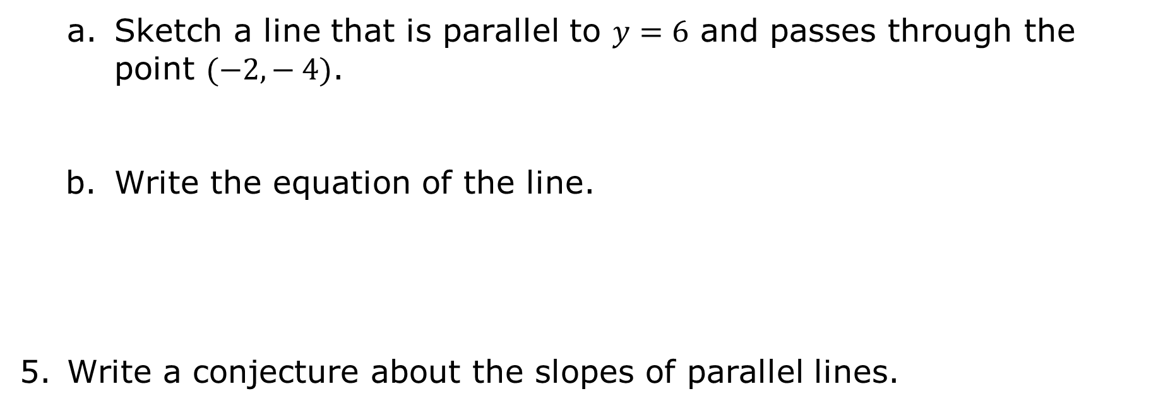
Sketch a line that is parallel to $y=6$ and passes through the point $(−2,− 4)$.
Write the equation of the line.
Write a conjecture about the slopes of parallel lines.
volume 1, pg. 210

Slide 16
Exploration
volume 1, pg. 211

Slide 17
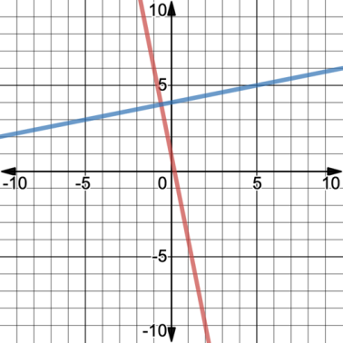
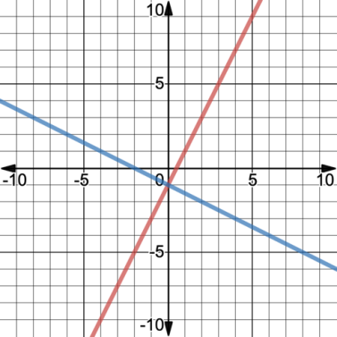
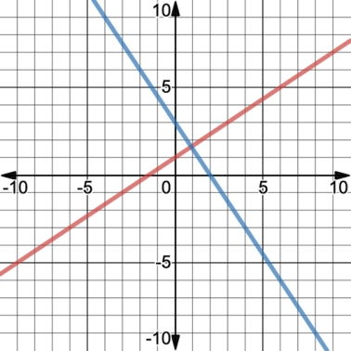
4.9.3 Exploration: Perpendicular Lines
Examine the pairs of perpendicular lines.
Perpendicular Lines Set A | Perpendicular Lines Set B | Perpendicular Lines Set C
volume 1, pg. 211

Slide 18
Write down your observations and questions.
Record your partner’s observations and questions.
Observations | Questions
Observations | Questions
volume 1, pg. 211

Slide 19
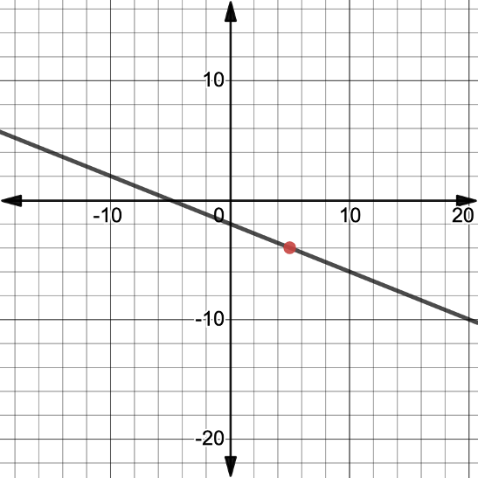
The graph of $y=−\frac{2}{5} x−2$is shown on the coordinate grid.
volume 1, pg. 211

Slide 20
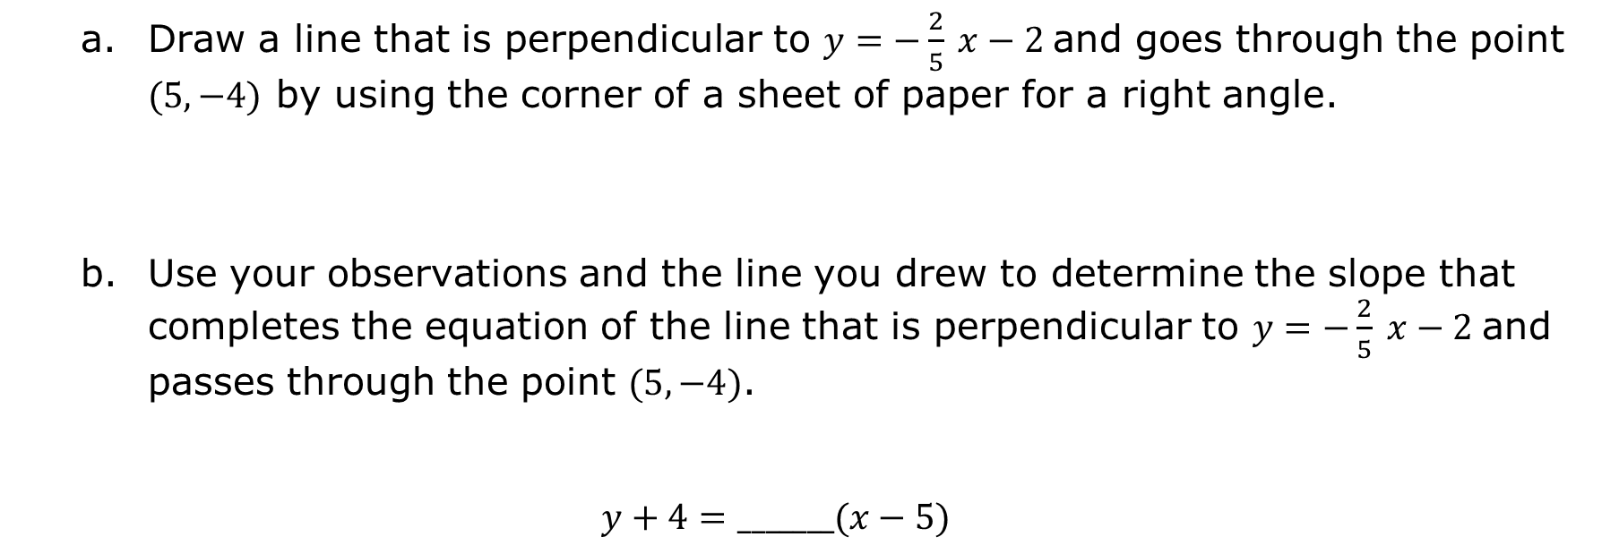
Draw a line that is perpendicular to $y=−\frac{2}{5} x−2$and goes through the point $(5,−4)$ by using the corner of a sheet of paper for a right angle.
Use your observations and the line you drew to determine the slope that completes the equation of the line that is perpendicular to $y=−\frac{2}{5} x−2$and passes through the point $(5,−4)$.
$$y+4=_______(x−5)$$
volume 1, pg. 211

Slide 21
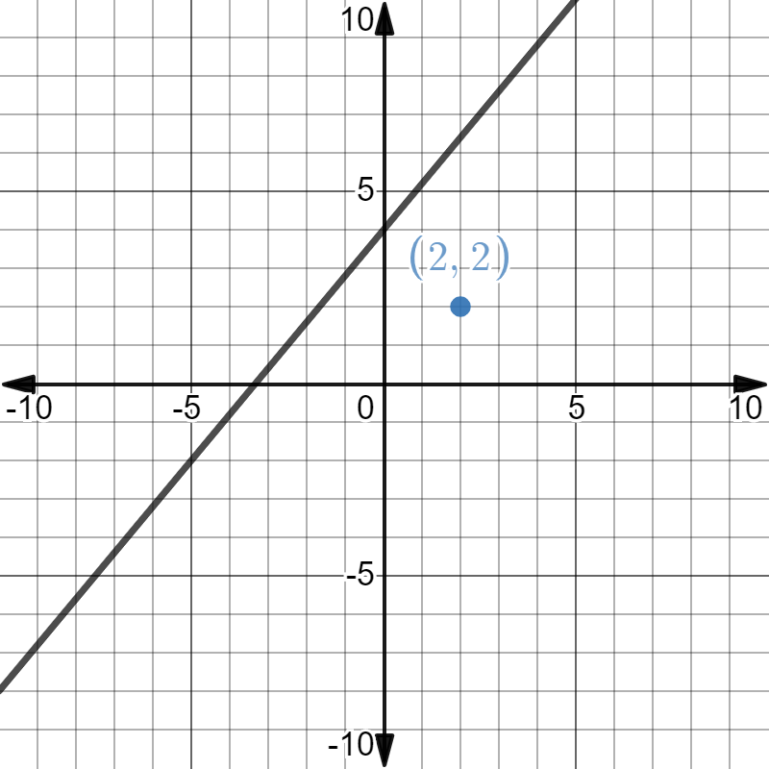
The graph of $6x−5y=−20$is shown on the coordinate grid.
volume 1, pg. 212

Slide 22
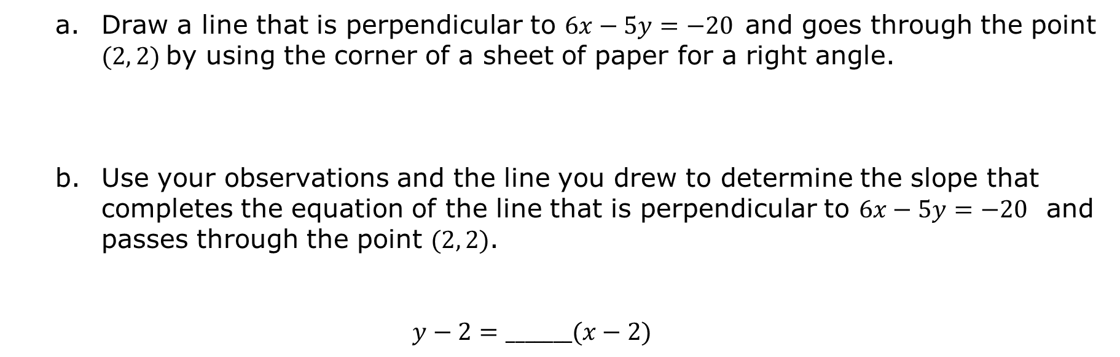
Draw a line that is perpendicular to $6x−5y=−20$and goes through the point $(2, 2)$by using the corner of a sheet of paper for a right angle.
Use your observations and the line you drew to determine the slope that completes the equation of the line that is perpendicular to $6x−5y=−20$ and passes through the point $(2, 2)$.
$$y−2=_______(x−2)$$
volume 1, pg. 212

Slide 23
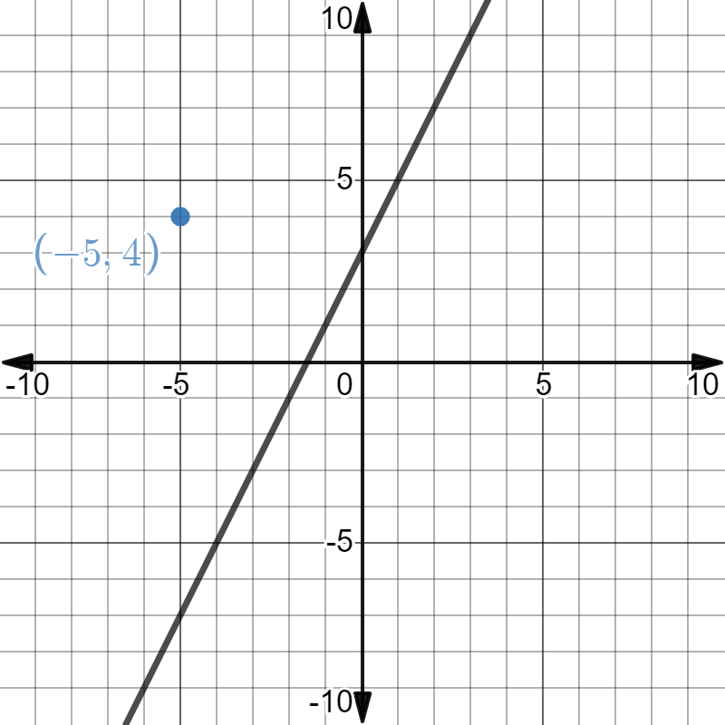
The graph of $y−5=2(x−1)$is shown on the coordinate grid.
volume 1, pg. 212

Slide 24
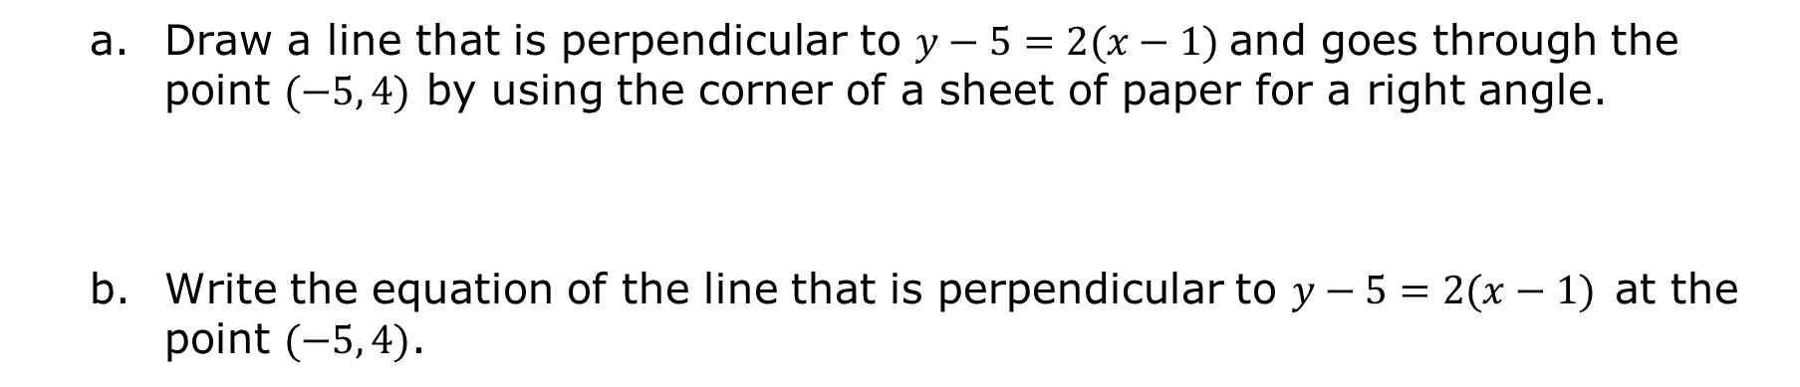
Draw a line that is perpendicular to $y−5=2(x−1)$and goes through the point $(−5, 4)$ by using the corner of a sheet of paper for a right angle.
Write the equation of the line that is perpendicular to $y−5=2(x−1)$at the point $(−5, 4)$.
volume 1, pg. 212

Slide 25
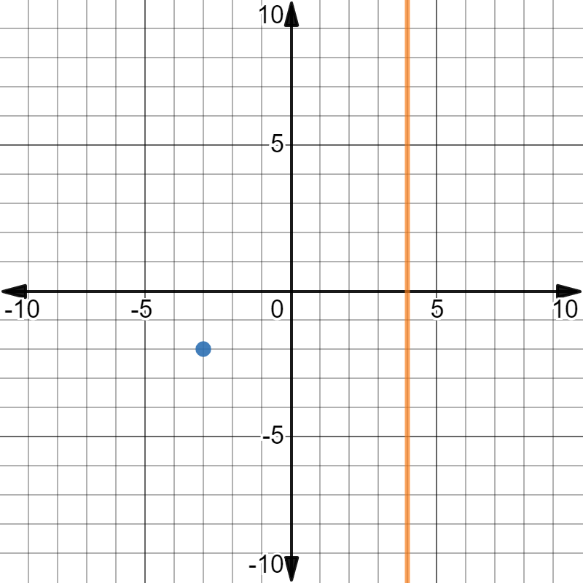
The graph of $x=4$is shown on the coordinate grid.
volume 1, pg. 213

Slide 26
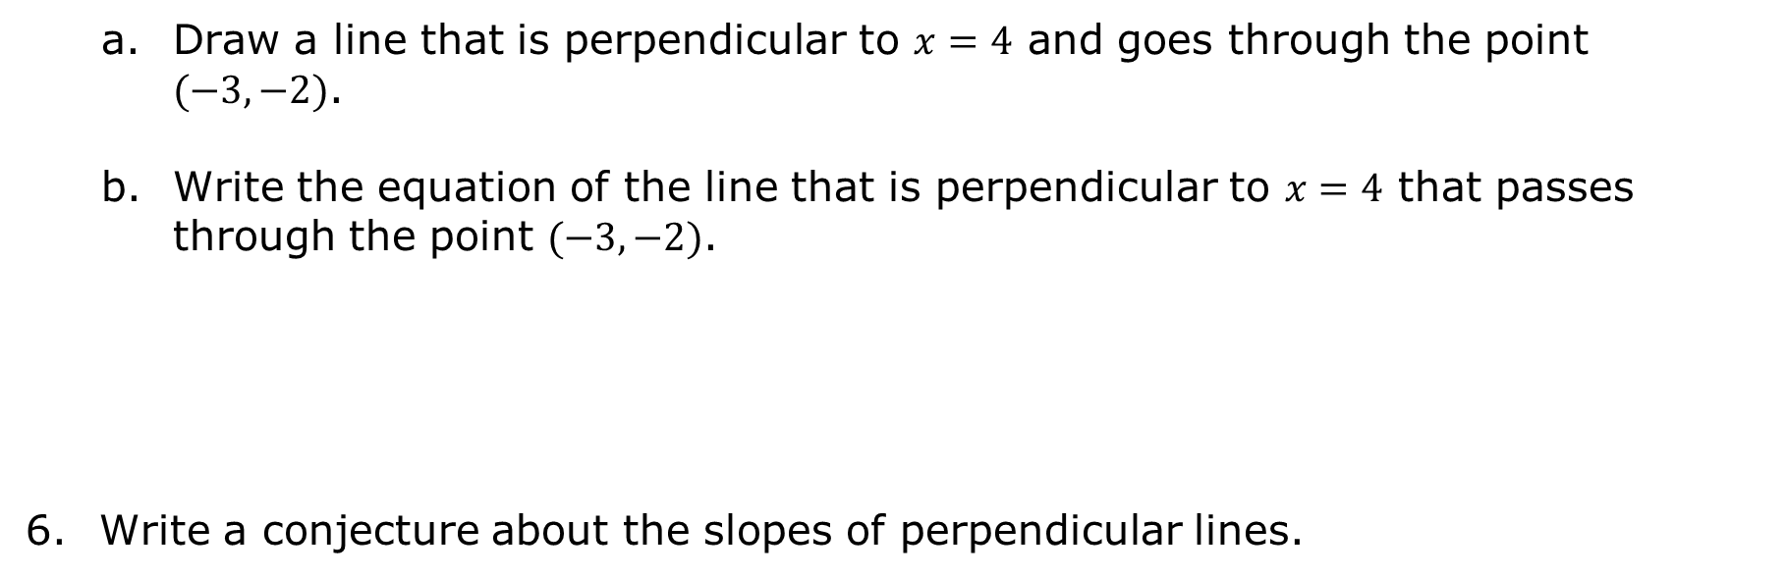
Draw a line that is perpendicular to $x=4$ and goes through the point $(−3, −2)$.
Write the equation of the line that is perpendicular to $x=4$ that passes through the point $(−3, −2)$.
Write a conjecture about the slopes of perpendicular lines.
volume 1, pg. 213

Slide 27

Wrap-Up
volume 1, pg. 213

Slide 28
4.9.4 Wrap-Up: Ticket Out the Door
Match the two lines that are parallel and the two lines that are perpendicular. Then, match the equations.
 | Lines | Equations
Parallel
Perpendicular
volume 1, pg. 213

Slide 29
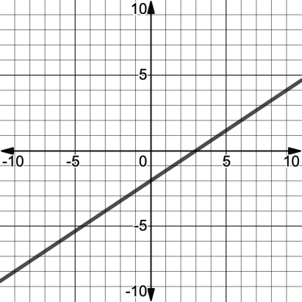
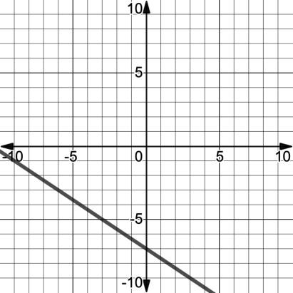
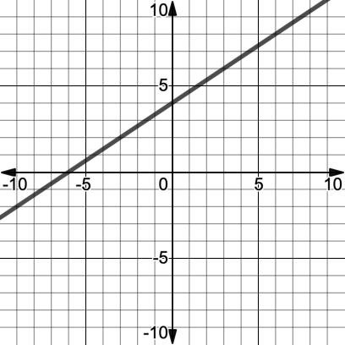
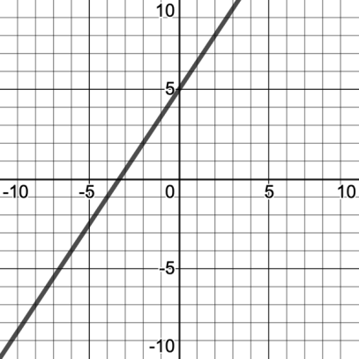
Line A | Line B
Line C | Line D
volume 1, pg. 213

Slide 30
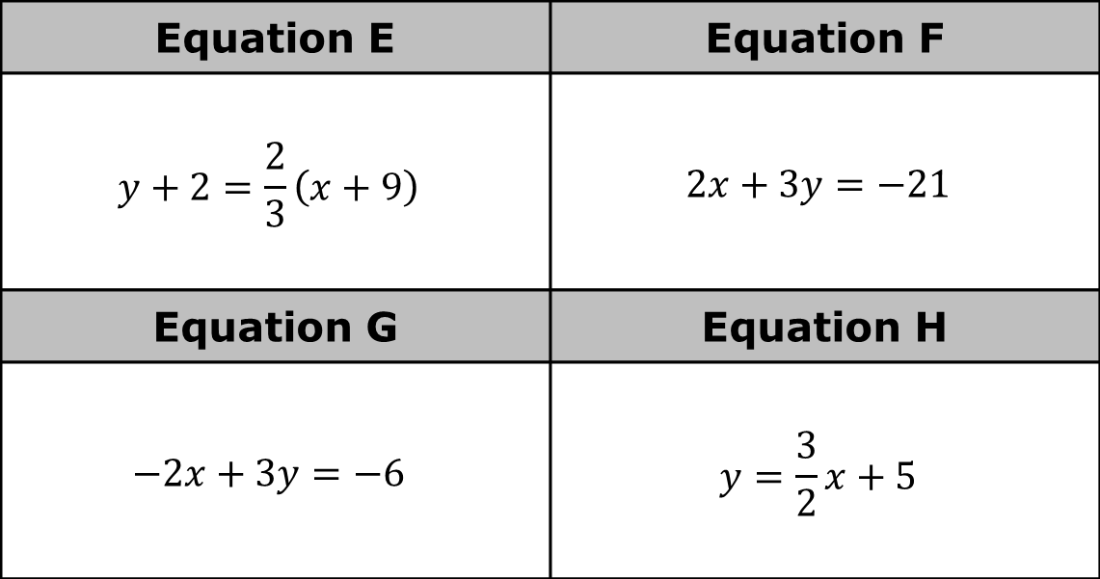
Equation E | Equation F
$$y+2=\frac{2}{3}\left(x+9\right)$$ | $$2x+3y=−21$$
Equation G | Equation H
$$−2x+3y=−6$$ | $$y=\frac{3}{2}x+5$$
volume 1, pg. 213

